Slide 1

Automated Filtration of Synthetic Media in Content Sharing Platforms Using Multiple Models
Arun Kumar M(24MDT1131)
Under the guidance of
Dr. Hannah Grace G
Department of Mathematics
School of Advanced Sciences
Vellore Institute of Technology Chennai

Slide 2
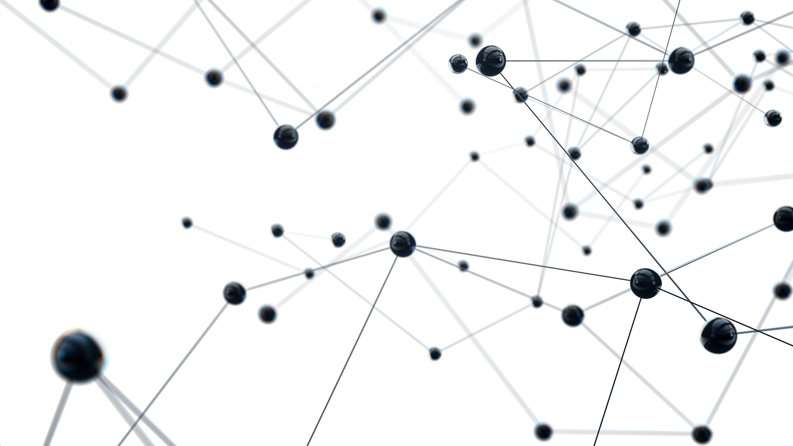
Table of Contents
Problem Statement
Aim and Objective
Literature Reviews
Workflow
Data Collection & Preparation
EXIF Layer: Automated Metadata Filtering
Multi-Model AI Classification
GUI of AI Text Classification model
Future Scope
References

Slide 3
Problem Statement
The rapid advancement of AI image generators has made it exceedingly difficult to reliably distinguish between real and synthetic images.
Existing single-model classifiers standard CNNs and heavy Vision-Language Models suffer significant accuracy drops when exposed to complex, "in-the-wild" media containing heavy semantic noise, low-level forensic artifacts, text overlays, and diverse artistic styles.
The current industry landscape heavily relies on massive, multi-model ensembles. these ensemble models are computationally expensive, resource-intensive, and fundamentally too slow for real-time deployment.
There is an urgent need for a streamlined, single-pass classifier capable of matching the robustness and precision of heavy ensemble models to classify AI images and Real images, without the associated computational burden.

Slide 4
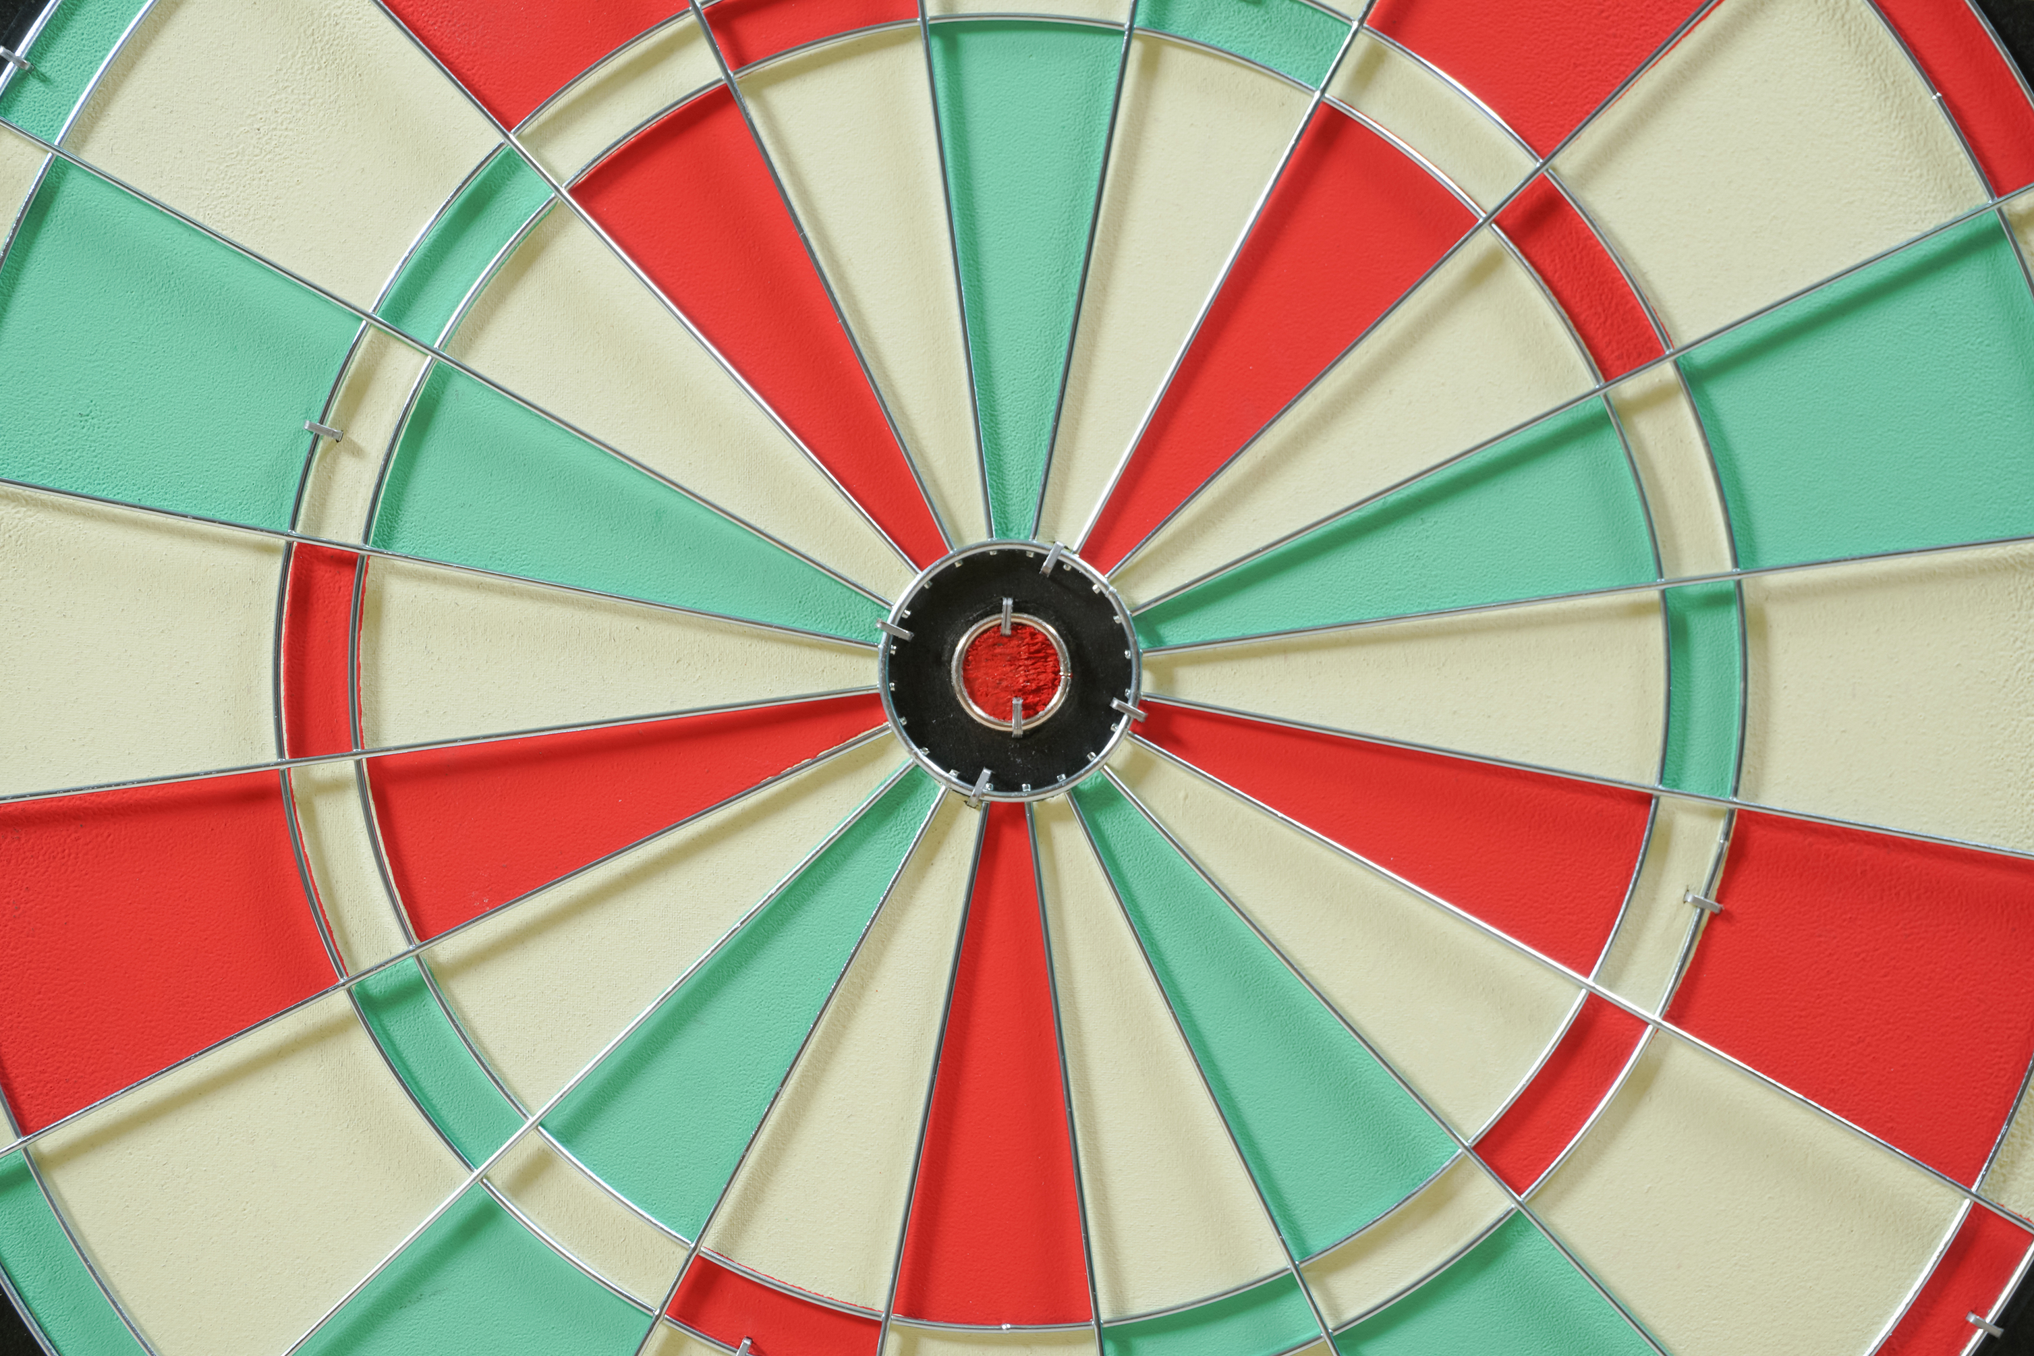
Aim and Objective
To develop an efficient, highly robust, single-pass AI image classifier based on a modified SigLIP 2 architecture that matches the accuracy of complex multi-model ensembles while ensuring low computational overhead and scalability for real-time deployment.
Isolate the spatial feature extraction capabilities of the SigLIP 2 model by intentionally removing its text-processing components, thereby drastically reducing memory footprint and inference time.
Integrate a custom weighted loss function to natively handle class imbalances within the training data
Utilize Test-Time Augmentation (TTA) to match ensemble-level accuracy and robustness in a single forward pass, providing a practical solution for real-time AI image detection.

Slide 5

Literature Gap
Current AI detectors rely on older architectures CNNs and ViTs. A critical gap exists in utilizing the vision components of modern Vision-Language Models (VLMs). Because VLMs are trained to deeply understand image details, they are uniquely equipped to catch subtle artifacts from AI generated images.
No model deeply tested on hard negatives images.
To achieve state-of-the-art robustness, the industry currently resorts to computationally massive, high-latency ensembles.
There is a critical gap for streamlined, single-pass architectures that can match this robustness while operating efficiently enough for real-time web deployment.

Slide 6
Literature Reviews
S.No | Author | Title / Journal | Dataset Used | Key Contribution
1 | Ziqiang Li, Jiazhen Yan et al. | Is Artificial Intelligence Generated Image Detection a Solved Problem? (arXiv 2025) | AIGIBench (a benchmark comprising 23 diverse subsets of fake images, alongside real images sampled from FFHQ, CelebA-HQ, and Open Images V7). | Introduces AIGIBench to evaluate the robustness and generalization of 11 advanced detectors across multi-source generalization, image degradation, data augmentation, and pre-processing, revealing significant performance drops on real-world data and highlighting vulnerabilities to perturbations like JPEG compression
2 | Simiao Ren, Yuchen Zhou et al. | How well are open sourced AI-generated image detection models out-of-the-box: A comprehensive benchmark study (arXiv 2026) | GenImage, AIGCDetectionBench, WildFake, OpenFake, Diffusion 1kstep, SynthBuster | Presents the first comprehensive zero-shot evaluation of 16 state-of-the-art detection methods, demonstrating massive performance gaps, ranking instability, and the dominance of training data alignment over architecture.
3 | Alan Perotti, Marco Nurisso et al. | No Detector to Rule Them All (ACM Multimedia 2025) | COCO, ImageNet, celeba | Benchmarked open-source deepfake detectors, showing poor cross-model generalization, and demonstrated that ensemble methods with latent feature fusion achieve state-of-the-art robustness over single binary classifiers.

Slide 7
Literature Reviews (contd.)
S.No | Author | Title / Journal | Dataset Used | Key Contribution
4 | Bilva Chandra | Analyzing Harms from AI-Generated Images and Safeguarding Online Authenticity (RAND 2024) | LAION-5B | Outlines safety harms misinformation from AI image generators and evaluates industry solutions for content authenticity, proposing policy measures like NIST standards and FTC actions.
5 | Michael Tschannen et al. | SigLIP 2: Multilingual Vision-Language Encoders with Improved Semantic Understanding (arXiv 2025) | WebLI 10B | Introduces SigLIP 2 with pairwise sigmoid loss and "NaFlex" resolution handling, providing the dense feature extraction necessary for visual forensics.
6 | Huan Liu, Zichang Tan et al. | Forgery-aware Adaptive Transformer for Generalizable Synthetic Image Detection (CVPR 2024) | ProGAN | Introduced FatFormer, a novel forgery-aware adaptive transformer that builds on the pre-trained vision-language spaces of CLIP. It demonstrated strong robustness, achieving 98% average accuracy on unseen GANs and 95% on unseen diffusion models.
7 | Harshit et al. | Deepfake Detection using Efficientnet-B0 and GRU (IJERT 2025) | FaceForensics++ | Demonstrates a streamlined hybrid architecture (EfficientNet+GRU) for real-time detection, emphasizing computational efficiency for web deployment.
8 | Geeta Rani, Atharv Kothekar et al. | Lightweight and hybrid transformer-based solution for quick and reliable deepfake detection (Frontiers 2025) | Celeb DF-v2, iBUG 300-W | Proposes a hybrid architecture combining Vision Transformer (ViT) and Linformer models for deepfake video detection, which significantly reduces execution time and computational overhead while achieving a high detection accuracy of 98.9%.

Slide 8

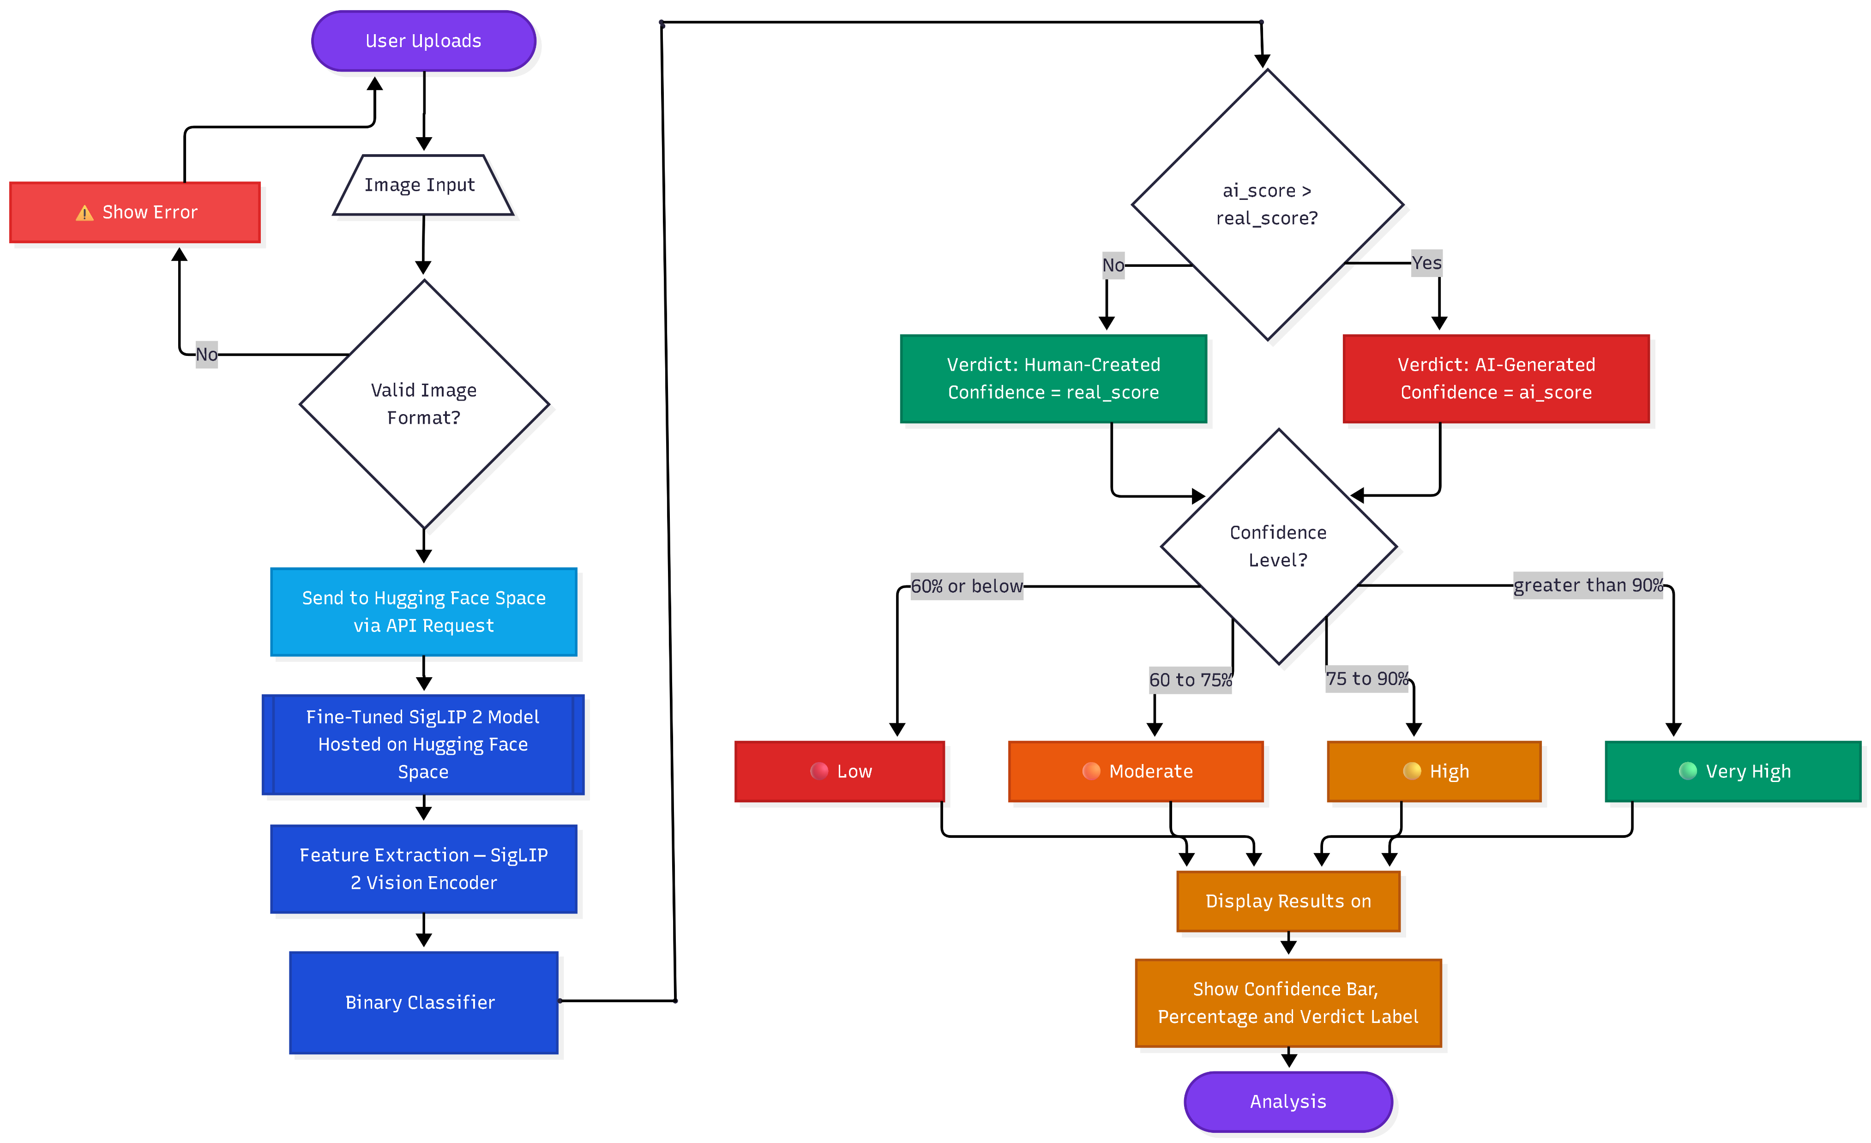
Workflow

Slide 9
Data Collection & Preparation
Data types | Source | Volume
Image | Reddit, Discord, Sora gallery, ideogram explorer, Kaggle | 4k real images and 4k AI images

Slide 10
EXIF Layer: Automated Metadata Filtering
The system instantly extracts hidden technical data (EXIF) from uploads, revealing details like software used, creation date, and device information.
Files identified as synthetic here are rejected instantly, saving processing power by preventing them from reaching the complex deep learning models.

Slide 11
Multi-Model AI Classification
Distilled DeBERTa: Textual content is analyzed by a Distilled DeBERTa classifier optimized using Llama 3-8B data. This teacher-student distillation approach allows the smaller DeBERTa model to recognize the unique “patterns“ which taught by teacher model
SigLIP: The SigLIP (Sigmoid Loss for Language Image Pre-training) model is utilized to categorize images as either authentic human photography or generative AI media. It is particularly fine-tuned on "hard negatives“ such as memes
SigLIP + GRU Hybrid: A hybrid deep learning architecture is employed for complex video and motion analysis. SigLIP serves as the frame-level feature extractor to identify spatial anomalies within individual images. These features are then fed into a Bidirectional GRU (Gated Recurrent Unit), which performs a temporal sequence analysis to detect motion inconsistencies

Slide 12
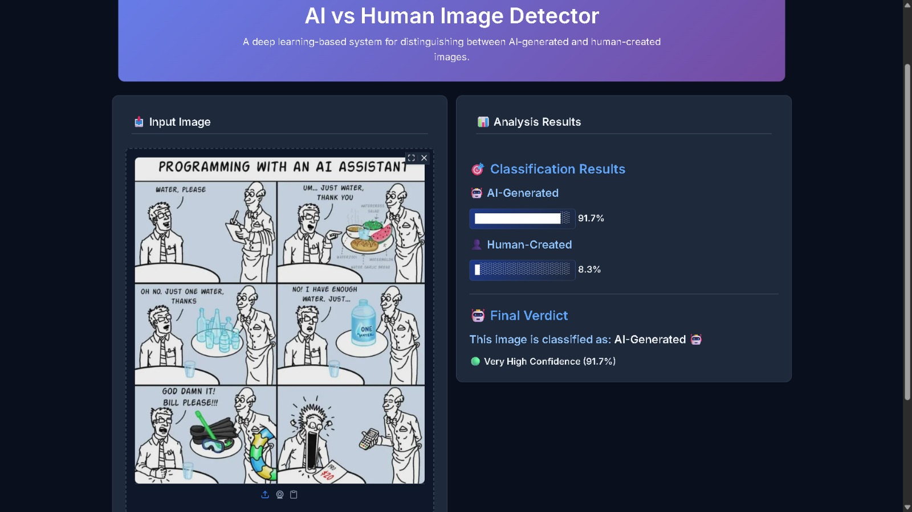
GUI of AI Text Classification model

Slide 13
Future Scope
Explainable AI (XAI) Integration on AI classification models
Design and implement audio AI classification
Establish an automated feedback loop where "hard negatives" (false positives/negatives) reported by users are automatically added to the training dataset to retrain and update the models dynamically.

Slide 14
References
Any-Resolution AI-Generated Image Detection by Spectral Learning (2025), Dimitrios Karageorgiou, Symeon Papadopoulos, Ioannis Kompatsiaris, Efstratios Gavves, https://doi.org/10.48550/arXiv.2411.19417.
Deepfake Detection using Efficientnet-B0 and GRU (2025), G. Harshit, M. Chakradhar Reddy, Y.V.S. Sarath, https://doi.org/10.5281/zenodo.18106890.
Human-AI Collaborative Text Classification with DeBERTa-enhanced Contextual and Geometric Attention (2025), Tufeng Xian, Yong Zhong, Fen Liu, Meifang Xie, Qiyuan Sun, Miaoji Zheng, Weidong Wu, Zhiliang Zhang, https://ceur-ws.org/Vol-4038/paper_331.pdf.
SigLIP 2: Multilingual Vision-Language Encoders with Improved Semantic Understanding, Localization, and Dense Features (2025), Michael Tschannen, Alexey Gritsenko, Xiao Wang, Muhammad Ferjad Naeem, Ibrahim Alabdulmohsin,
https://doi.org/10.48550/arXiv.2502.14786.
Forgery-aware Adaptive Transformer for Generalizable Synthetic Image Detection (2024), Huan Liu, Zichang Tan, Chuangchuang Tan, Yunchao Wei, Yao Zhao, Jingdong Wang, https://doi.org/10.48550/arXiv.2312.16649.

Slide 15

Thank you

